Slide 1
Real Autobots and Decepticons Programming a Self-Configuring Robot
Carter Chase, Jeff Ross, Trevor Seitz, Ben Smith, Dr. John Licato
Notes:
Ben

Slide 2
Outline
Overview
Design
Demo
Work Breakdown
Q & A
Notes:
Ben

Slide 3
Overview
Notes:
Carter

Slide 4
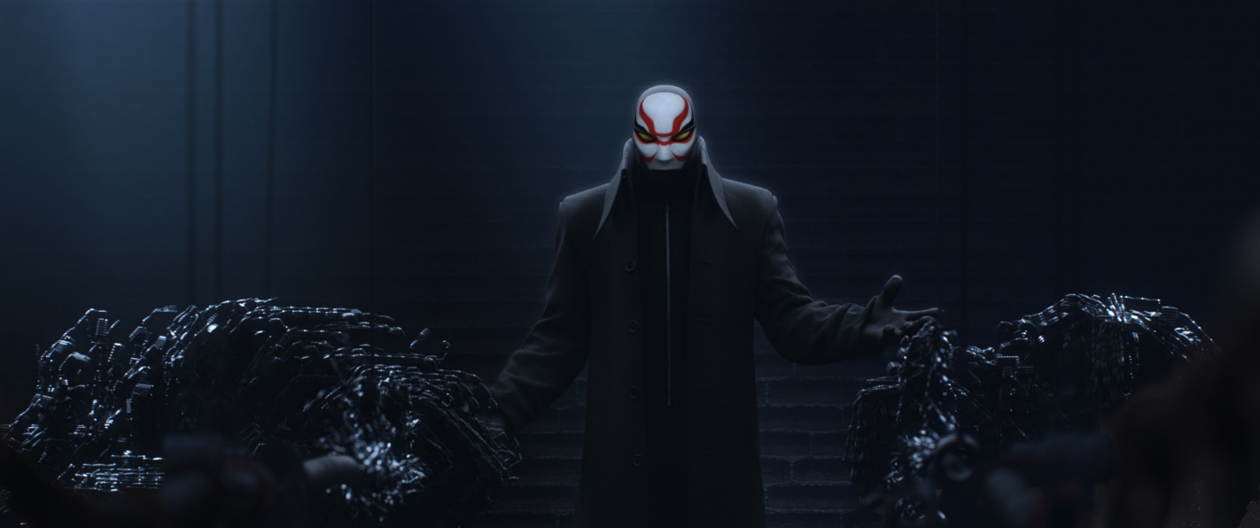
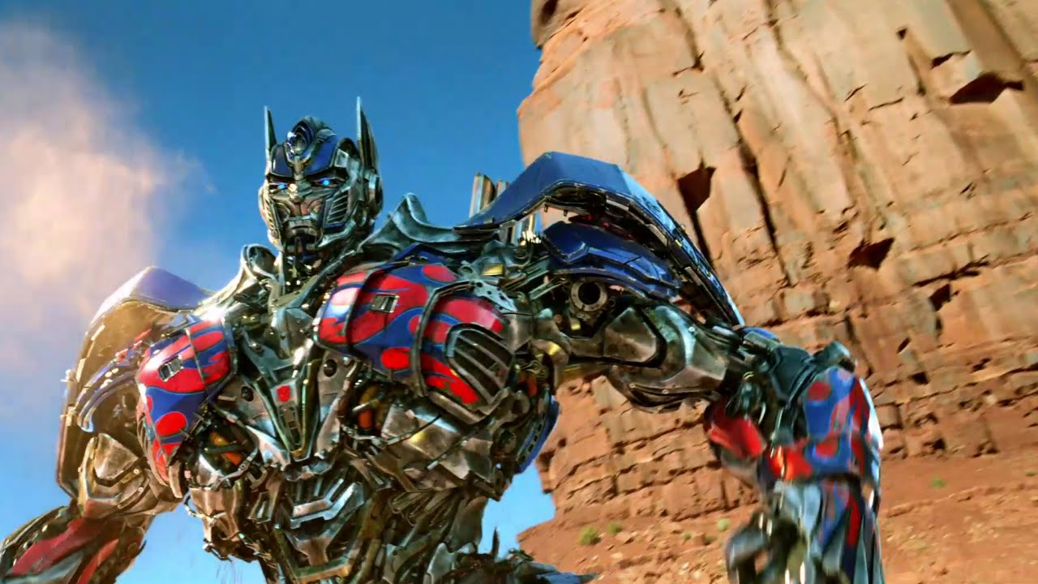
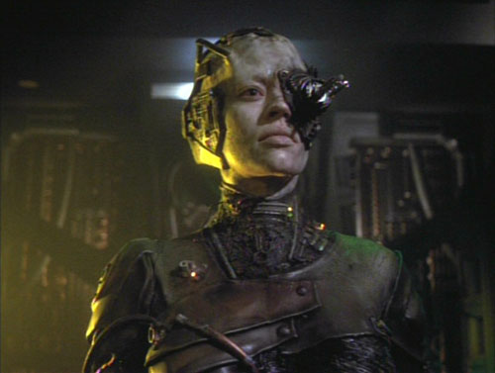
Purpose
Notes:
Carter

Slide 5
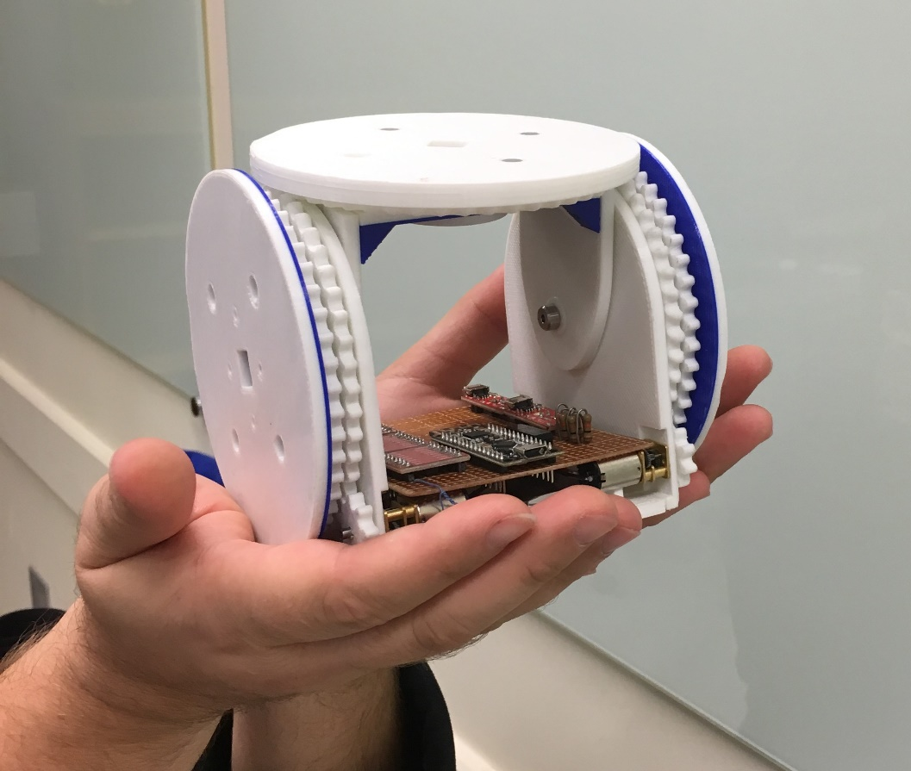
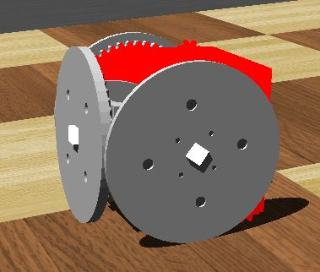
Problem Statement
Notes:
Carter

Slide 6
Problem Statement
Unaided organization of modules into a predetermined formation from random starting points.
Notes:
Carter

Slide 7
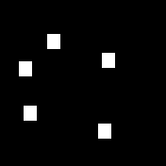
Problem Statement
Notes:
Carter

Slide 8

Problem Statement
Notes:
Carter

Slide 9
Requirements
Robot Movement
Simulator Model
Python Controller
AI Algorithms
Localization Algorithm
Pathfinding Algorithm
Notes:
Carter

Slide 10
Design
Notes:
Jeff

Slide 11
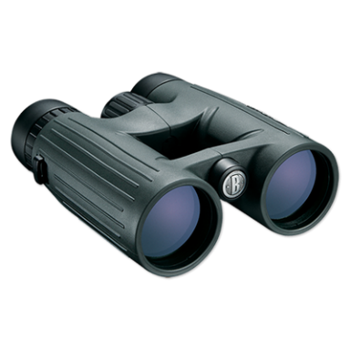


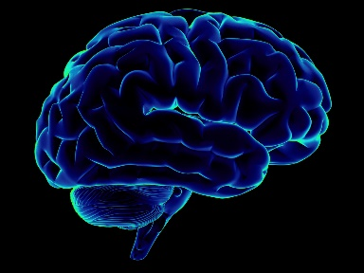
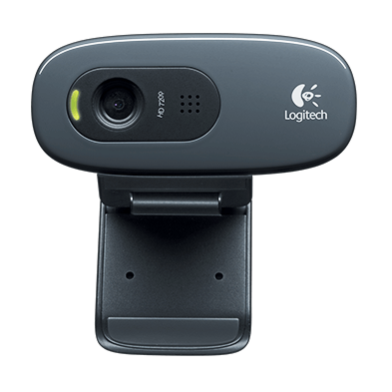
Centralized Architecture
Notes:
Jeff

Slide 12
Controller Workflow
Localize
Align Robots
Assign Goals
Find the Path
Notes:
Jeff

Slide 13
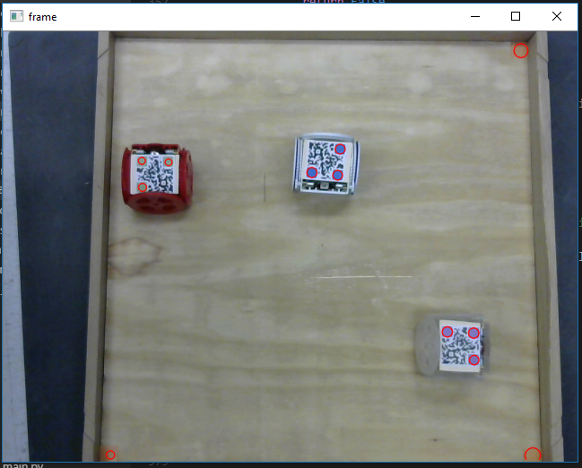
Localization
Top Down View
Colored QR codes
Notes:
Trevor

Slide 14
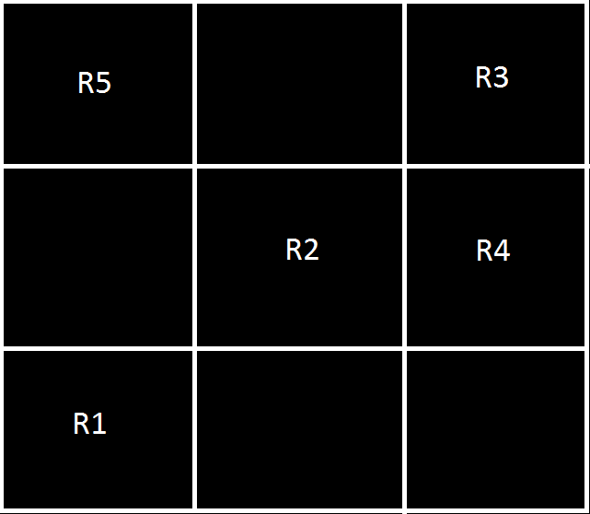
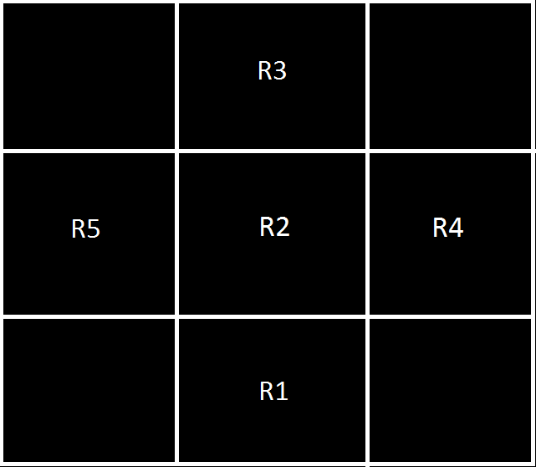
Pathfinding with PDDL
Notes:
Ben

Slide 15
Pathfinding with PDDL
Pros:
Robust
Multiple agents
Cons:
Manhattan Distance
Grid Alignment
Processing Heavy
Notes:
Ben

Slide 16
Demo
Notes:
Ben

Slide 17
Simulator
https://youtu.be/Ewe9AoiueLo
Notes:
Ben

Slide 18
Real World
https://youtu.be/vKyUqgo7r8w
Notes:
Trevor

Slide 19
Work Breakdown
Notes:
Jeff

Slide 20
Team Breakdown
Category | Work Started | Total Hours
Meetings | 04/22/2016 | 263.75
Summer | 06/20/2016 | 74.0
Simulator Model | 08/26/2016 | 164.5
Documentation | 08/27/2016 | 79.25
Python Controller | 08/30/2016 | 122.5
Robot Movement | 09/17/2016 | 63.0
AI Algorithms | 12/24/2016 | 444.75
TOTAL |  | 1211.75
Notes:
Jeff

Slide 21
Team Breakdown
Category | Carter Chase | Jeff Ross | Trevor Seitz | Ben Smith
Meetings | 71.25 | 64 | 63.5 | 65
Summer | 10 | 8 | 50 | 6
Simulator Model | 15.5 | 63.75 | 0 | 85.25
Documentation | 54.5 | 8.5 | 11.75 | 4.5
Python Controller | 57.5 | 0 | 65 | 0
Robot Movement | 8.5 | 27.75 | 26.75 | 0
AI Algorithms | 83.25 | 104.5 | 161.75 | 95.25
Total | 300.5 | 276.5 | 378.75 | 256
Notes:
Jeff

Slide 22
Q & A
Notes:
Carter

